Slide 1
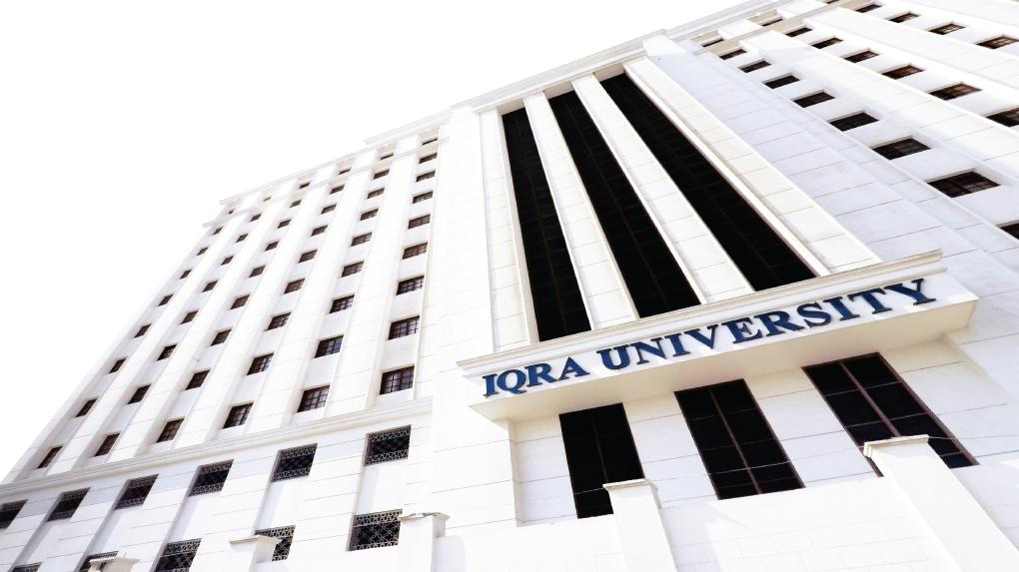

Inclusion-exclusion principle
LECTURE 14
Adapted from :
https://www.genrica.com/vustuff/MTH202/MTH202_handouts_1_45.pdf

Slide 2
Learning Outcomes
After completing this lecture satisfactorily, a student will:
• Be able to construct simple mathematical proofs and possess the ability to
verify them.
Have substantial experience to comprehend formal logical arguments.
• Gain experience in using various techniques of mathematical induction
(weak, strong and structural induction) to prove simple mathematical
properties of a variety of discrete structures.

Slide 7
Review Questions
What is Pigionhole principal?
Differentiate between Inclusion-exclusion principle.

Slide 8
Thank you

